Slide 1


Lisboa: 02/05/2019

Slide 2

What makes æternity different?
æternity’s goal is to provide one of the most powerful blockchain platforms in the industry with a very reliable on-chain and off-chain performance, while still remaining decentralized.
Not ignoring important aspects:
open code
200 years
stable releases
dev instruments
readable language
active community
aeternity.com | @aeternity blocksult.com | @serejandmyself

Slide 3
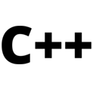
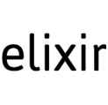


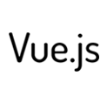


Technology
Some of the technology we use:
You can find a full list on our GitHub: https://github.com/aeternity
aeternity.com | @aeternity blocksult.com | @serejandmyself

Slide 4
What is æternity?
An open-source, blockchain 3.0 æpps platform.
Solving current problems in blockchain, ie:
scalability
governance
usability
efficiency
real world data
contract security
aeternity.com | @aeternity blocksult.com | @serejandmyself

Slide 5
Why æternity?
Scalability.
On-Chain (Layer 1)
Bitcoin-NG
using the Cuckoo Cycle Proof of Work mining algorithm
Off-Chain (Layer 2)
State Channels
aeternity.com | @aeternity blocksult.com | @serejandmyself
Notes:
Has anybody already heard about these 2 approaches?
For solving scalability issues on Layer 1 æternity chose to implement Bitcoin-NG
NG is the short term for “next generation”
Cuckoo Cycle:
a memory-bound graph-theoretic proof-of-work system
very energy efficient
allows for instant verification of solved puzzles
aimed to be ASIC resistant and allow mining on smartphones
this isn’t true anymore
used by other prominent projects, for example Grin
On Layer 2 scalability issues are solved by using state channels:
Two participants agree to open a channel
Transactions can then be performed off-chain and calling the blockchain is only needed to either solve disputes or close the channel
State channels in Æternity are native:
no need to rely on any 3rd party solution where security could be compromised
Key features of state channels:
Privacy
Transactions within the channel are only known by the two participants
Instant transactions
No need to wait for on-chain confirmations
Low costs
Off-chain transactions are free
Only transactions for creating, updating or closing a channel need to be performed on-chain

Slide 6
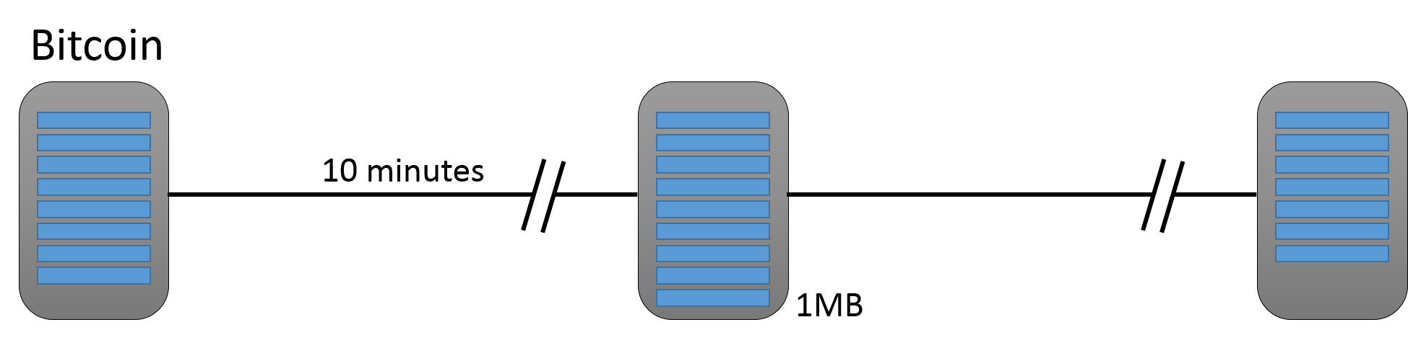
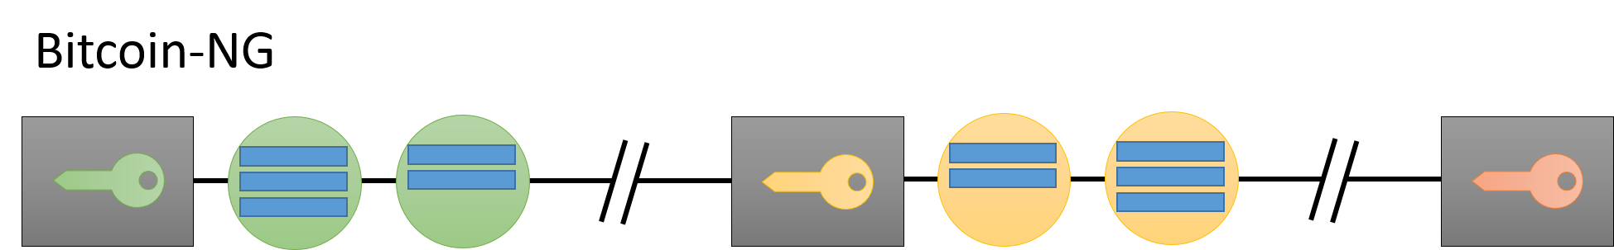
On-Chain: Bitcoin-NG
Fast, Secure, and Decentralized
aeternity.com | @aeternity blocksult.com | @serejandmyself
Notes:
On average in Bitcoin blocks are broadcasted every 10 minutes
it is driven by protocol and guarded by target and Proof of Work
Aeternity assumed 3 minutes for Key Blocks and 3 seconds time delta between Micro Blocks
3 minutes resolution of Key Blocks is also guarded by target and Proof-of-Work
Rewards:
Next leader gets fixed KeyBlock coinbase award + 60% of fees from the previous generation of Micro Blocks
The previous leader receives 40% of the fees included in transactions he confirmed
Through the use of Bitcoin-NG Æternity can handle ~100tx/s
In comparison:
Ethereum ~15-25tx/s
Bitcoin ~7-30tx/s

Slide 7
Why æternity?
Cuckoo Cycle PoW.
æternity uses the Cuckoo Cycle, a memory bound mining algorithm, rather than raw processor speed, in order to achieve the greatest decentralization possible.
PoW might use 100% of your CPU (70W) (PoW normally uses GPU for mining instead of CPU or 120W or higher). The Cuckoo Cycle only uses 54W of power to fully saturate the memory of your machine.
aeternity.com | @aeternity blocksult.com | @serejandmyself
Notes:
Was originally thought to be asic resistant but now is not. But is still very graphic card friendly.

Slide 8
Why æternity?
Scalability via State Channels.
State channels provide a method for users to privately communicate and transact off-chain. æternity’s method for reducing the on-chain load.
Only in the case of a disagreement between the contracting parties does the æternity blockchain enforce the smart contract code.
Increases scalability by reducing the number of transactions on chain.
aeternity.com | @aeternity blocksult.com | @serejandmyself
Notes:
Scalability, right now, is the largest problem that Bitcoin and Ethereum are facing. They have lighting and sharding where as æternity has state channels which are essentially peer to peer private transactions that happen off the blockchain. Which means no transaction costs and immediate transfers. And the way I see this is that, lighting and sharding are something bitcoin and ethereum are adding to their network while æternity will have it available from day 1. With state channels there’s no limit to the amount of transactions that can happen at once.

Slide 9
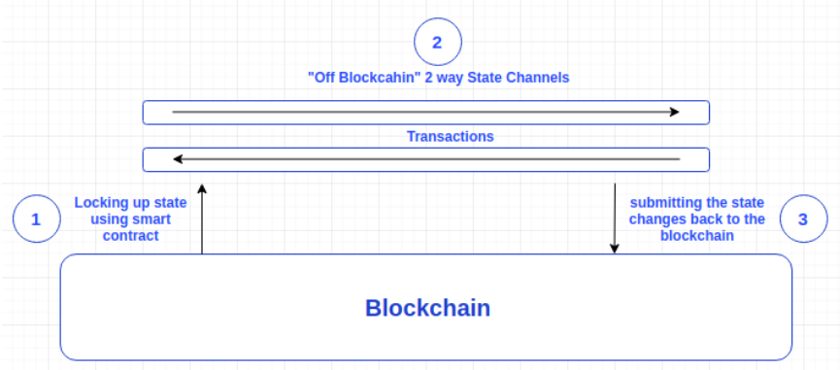
Off-Chain: State Channels
aeternity.com | @aeternity blocksult.com | @serejandmyself
Notes:
We start with the simplest form of state channels => payment channels
Bitcoin: Lightning Network
Ethereum: Raiden

Slide 10
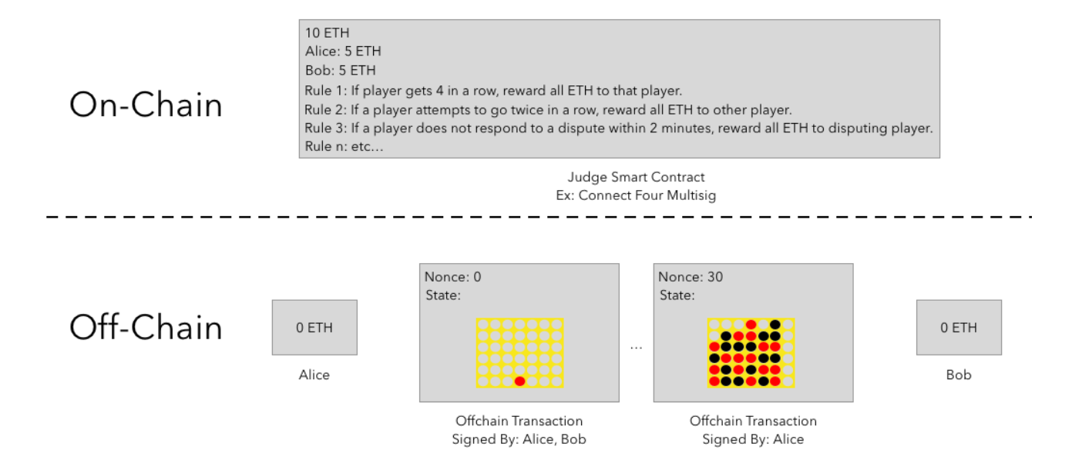
Off-Chain: State Channels
aeternity.com | @aeternity blocksult.com | @serejandmyself
Notes:
We start with the simplest form of state channels => payment channels
Bitcoin: Lightning Network
Ethereum: Raiden

Slide 11
Why æternity?
Oracles.
Oracles are source of information which can be accessed on the blockchain. Anyone can be an oracle provider, their reputation determines whether or not they are seen as a reliable source.
Structured data, that can be anything from a simple Boolean to the complete work of Shakespeare. Oracle responses can be used by smart contracts to perform certain actions based on the result
aeternity.com | @aeternity blocksult.com | @serejandmyself
Notes:
Oracles machines allow you to connect real world data to smart contracts such as election outcomes, weather, sport event results and commodity prices such as gold and oil.

Slide 12

Why æternity?
This is not an Oracle:
aeternity.com | @aeternity blocksult.com | @serejandmyself
Notes:
Oracles machines allow you to connect real world data to smart contracts such as election outcomes, weather, sport event results and commodity prices such as gold and oil.

Slide 13
Oracle characteristics
æternity provides an oracle state tree which contains objects and queries
an oracle defines:
an address that should be registered as an oracle
a request and a response format
a TTL (how long the oracle will be available)
a fee that a caller has to pay to get a response
operations on oracles:
register the oracle
subscribe to the oracle
answer queries from clients
possibly extend the lifespan of the oracle, by increasing its ttl
or expire
Sample Oracle: https://dev.aepps.com/aepp-sdk-docs/Oracle-Python.html
aeternity.com | @aeternity blocksult.com | @serejandmyself
Notes:
æternity provides an oracle state tree which contains
oracle objects
oracle query objects
an oracle defines
an address that should be registered as an oracle
a request and a response format
a TTL (how long the oracle will be available)
a fee that a caller has to pay to get a response
oracle-query transactions
contain a query TTL
contain a response TTL
create a new oracle query object
oracle-response transactions
modify the oracle query object by adding the response
Oracle query objects are
created by an oracle query transaction.
closed by an oracle response transaction.
immutable once it is closed.
deleted when it expires (When the query expire for an open query, and when the response expire for a closed query)

Slide 14
Why æternity?
Governance.
The governance of the blockchain is done by voting on the chain on proposals.
Delegated voting + technical tools.
Important aspects such as: reputation and cooperation.
aeternity.com | @aeternity blocksult.com | @serejandmyself

Slide 15
Why æternity?
æternity smart contract approach.
Contract execution should be safe, efficient, cheap, scalable + easily migrated.
Sophia is a new reason like programming language invented for the æternity virtual machine. Developers write smart contracts that run on the æternity blockchain in Sophia. Sophia’s syntax is derived from (OCaml/ReasonML).
Varna is a high level language, similar to Script in Bitcoin. Varna contracts do not contain any loops and the gas cost for a call is decided at compile time.
aeternity.com | @aeternity blocksult.com | @serejandmyself
Notes:
Check Https://dev.aepps.com for anyone interested in starting to develop smart contracts and æpps on æternity.

Slide 16
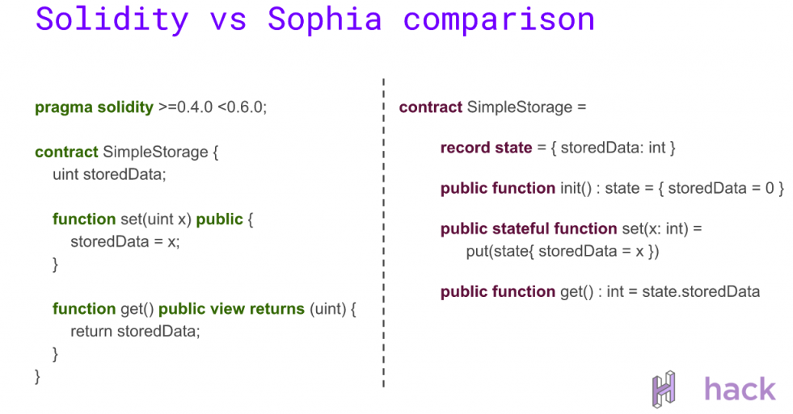
Source: https://hack.bg/blog/meetups/0x07-aeternity-sophia-ml-workshop-blockchain-developers-meetup/
aeternity.com | @aeternity blocksult.com | @serejandmyself
Notes:
Sophia is functional and each function is pure
calling the same function with the same input always leads to the same result
The only exception are stateful functions
Functions that change the state of a contract need to be declared as stateful

Slide 17
Adoption at æternity?
Product / UI / Mobility / Simplicity.
æternity enjoys simplicity of delivery of open source product to the end user. For example: dev portal, æpp portal, explorer that actually provides information in one place.
æternity is mobile friendly in its essence. No unnecessary and complicated information, which goes to prove that simplicity and product go hand in hand.
aeternity.com | @aeternity blocksult.com | @serejandmyself

Slide 18
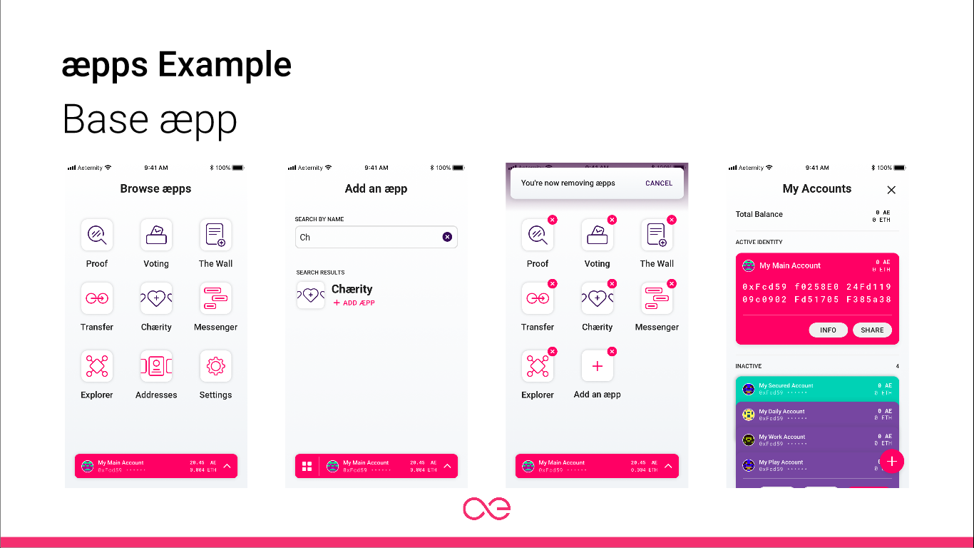
aeternity.com | @aeternity blocksult.com | @serejandmyself
Notes:
The Bæse æpp is the first decentralized application executed on top of the æternity blockchain. It will include your æternity wallet, a voting æpp for governance decisions based on Proof-of-Stake, an identity manager to choose real names for your public key, your smart contract or an oracle, as well as as messaging service and a blockchain explorer for the æternity blockchain.

Slide 19
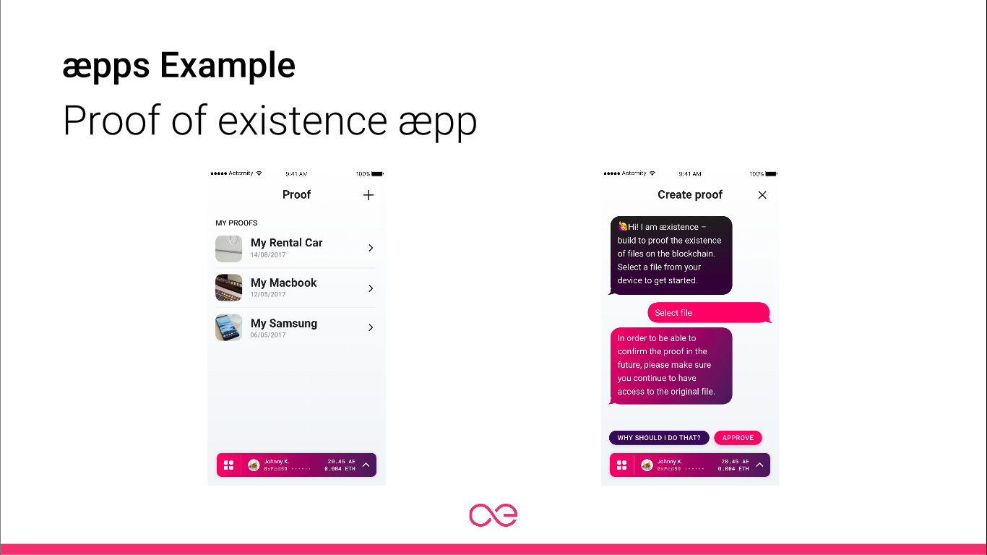
aeternity.com | @aeternity blocksult.com | @serejandmyself
Notes:
A very usefull æpp within bæse is the Proof æpp. It allows you to timestamp documents, pictures, music or videos on the æternity blockchain. This way you can always prove your ownership of your intellectual property through the hash which is included on a mined block on the blockchain. You can prove it by repeating the same process and showing that exactly the same hash is created. If there is anything different in the hash, the original file you timestamped was modified or manipulated.

Slide 20
Mainnet is live!
Build your own æpp.
Some of the first æpps are dedicated to groundbreaking use cases, such as:
Tokenized trust infrastructure based on machine learning
Electricity network governance for supply companies and cooperatives
Intellectual property management for artists and creators
IoT data search and filtering engine + AI analysis tools
First aid services for public motorbike transport
Proof of provenance for agroecological products
aeternity.com | @aeternity blocksult.com | @serejandmyself
Notes:
Check Https://dev.aepps.com for anyone interested in starting to develop smart contracts and æpps on æternity.

Slide 21
æternity ventures.
Be a part of æternity.
Incubator for Blockchain startups building applications on æternity platform:
Up to $250K
Up to 6 months incubation
Global workplace
Mentoring
Connect with devs
Already in action
aeternity.com | @aeternity blocksult.com | @serejandmyself
Notes:
Check Https://dev.aepps.com for anyone interested in starting to develop smart contracts and æpps on æternity.

Slide 22
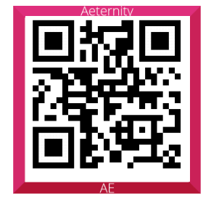
Join the local community on telegram
https://t.me/aeternitypt
or scan the QR-Code
aeternity.com | @aeternity blocksult.com | @serejandmyself

